Slide 1

2023-24 2-1 Interspecific competition between two species The Lotka-Volterra Interaction Model
Vincent Jansen
vincent.jansen@rhul.ac.uk

Slide 2
Outline
2-1 The Lotka-Volterra Interaction Model
2-2 Equilibria and Stability
2-3 Apparent Competition

Slide 3
Logistic Growth
rk
-rk

Slide 4
Intraspecific competition
Competition between individuals of the same species reduces the per capita growth rate
This can be for various reasons
Competition for resources (exploitation competition)
Direct effects (e.g. fighting, interference competition)
This motivated the logistic model for density dependent growth

Slide 5
Interspecific competition
Competition between individuals of different species also has the potential to reduce the growth rate
This can be for the same reasons
exploitation competition
interference competition

Slide 6
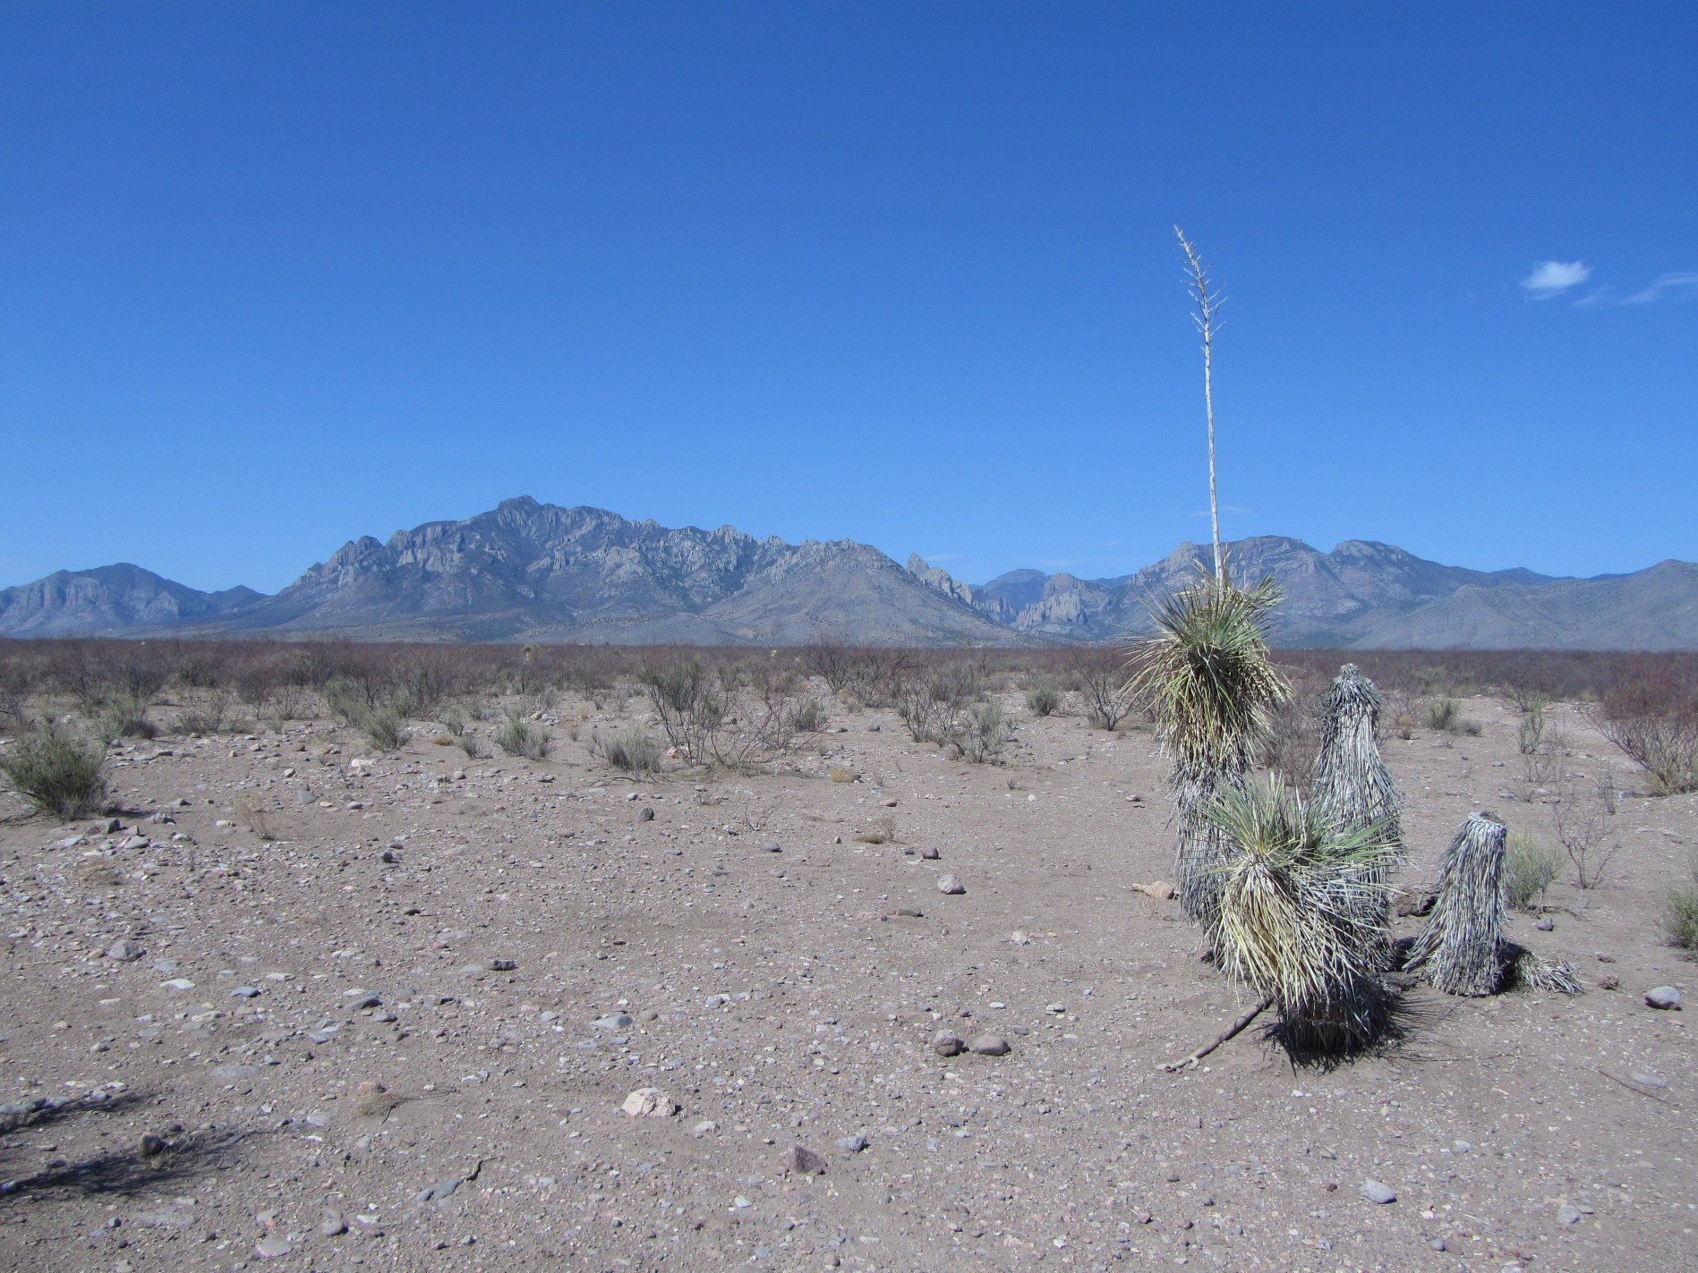
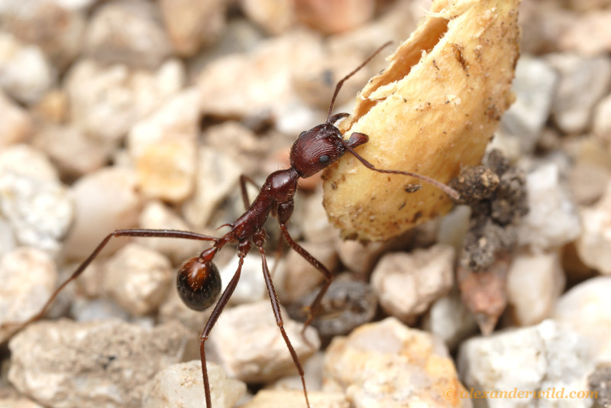
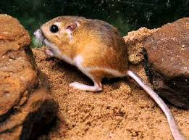
Notes:
Novomessor cockarelli granivorous ant, Dipodomys ordii, Ord’s kangaroo rat

Slide 7
Interspecific competition
 | Rodents removed | Ants removed | Rodents and ants removed | control
Ant colonies | 543 | - | - | 318
Rodent nrs | - | 144 | - | 122
Seed density relative to control | 1.0 | 1.0 | 5.5 | 1.0
Competition between rodents and granivorous ants (After Brown and Davidson, 1977)

Slide 8
Interspecific competition
Species coexist, but often do better in each other’s absence
Competition reduces the population size of the competitors

Slide 9
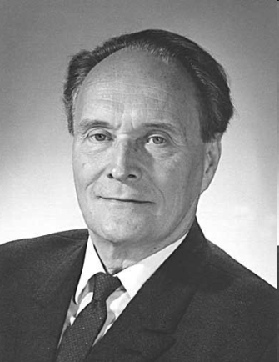
Gause’s experiments
G. F. Gause (1934) studied the competition between protozoans
He asked ‘will one species … drive the other one out completely, or will a certain equilibrium become established between them? ‘
Notes:
Gause applied for a fellowship through the Rockefeller Foundation to study with Pearl but was denied, perhaps because he was only 22 years old. He then published The Struggle for Existence in 1934 to improve his chances but he was still denied. Gause earned his BSc at Moscow University in 1931 and his DBiolSc in 1940.

Slide 10
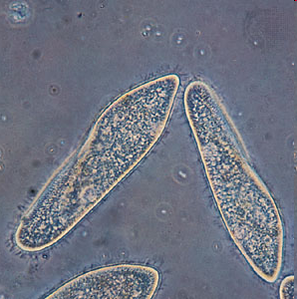
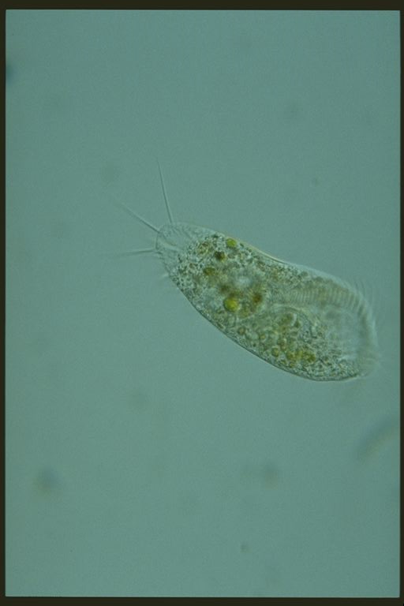
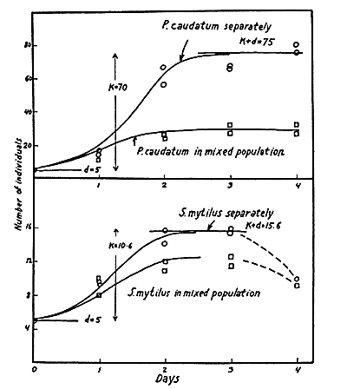

Gause’s experiments
He found coexistence
The population sizes are smaller in mixed cultures
Notes:
Stylonychia mytilus, Paramecium caudatum

Slide 11
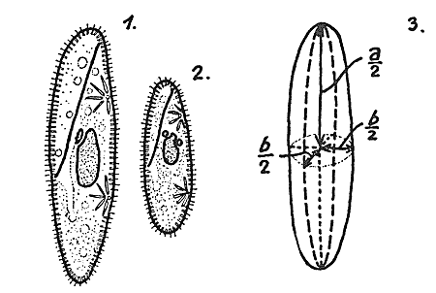
Gause’s experiments
Next look at the competition between two very similar species:
Paramecium caudatum
Paramecium aurelia

Slide 12
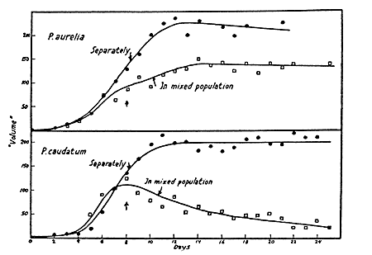
Gause’s experiments
He found exclusion of one species by another

Slide 13
Logistic Growth
Intraspecific competition can be described by the logistic model
The per capita growth rate decreased with increasing population size:

Slide 14
Generalised Logistic Growth
To describe competition between two species we will use
N₁: size of pop. of species 1
N₂: size of pop. of species 2
The max. per capita growth rate of species 1 is r₁, the carrying capacity of species 1 is k₁ (r₂, k₂ for species 2)

Slide 15
Generalised Logistic Growth
We will assume that the per capita growth rate of species 1 will decrease with the density of species 1 and species 2:
α is the competition coefficient (also called the equivalence number)
Population growth of species 1:

Slide 16
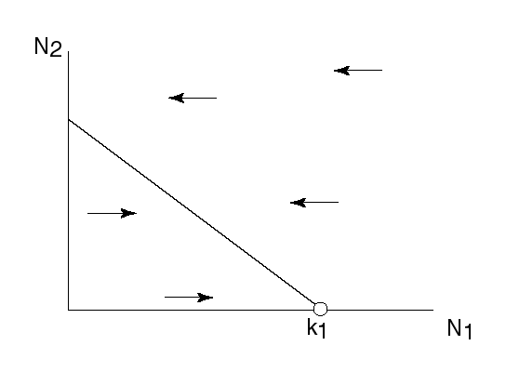
Generalised Logistic Growth
If the density of species 2 is constant, interspecific competition results in a reduction of the carrying capacity for species 1:
Or

Slide 17
Generalised Logistic Growth
Similarly, for the per capita growth rate of species 2 we assume:
β is the competition coefficient (also called the equivalence number)
Population growth of species 2:

Slide 18
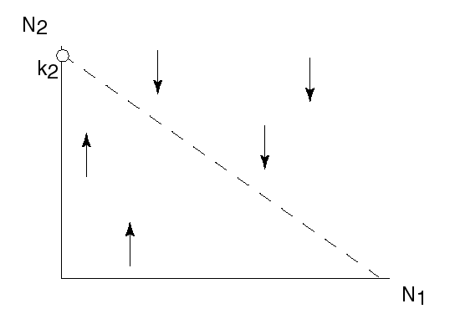
Generalised Logistic Growth
If the density of species 1 were constant, interspecific competition results in a reduction of the carrying capacity for species 2:
Or

Slide 19
Lotka-Volterra interaction model
The densities of the two species change simultaneously
This is described by a system of 2 differential equations:
This model is known as the Lotka-Volterra interaction model

Slide 20
Isoclines
The curves on which either species does not grow are called isoclines
The isoclines delimit the parts of the state space for which the density of that species increases or decreases in number
By combining the isoclines for the two species we can get an idea of the population dynamics

Slide 21
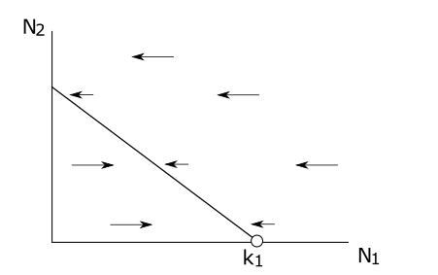
Isoclines

Slide 22
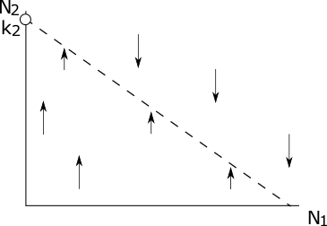
Isoclines

Slide 23
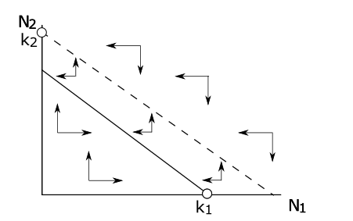
Inferring dynamics from the isoclines

Slide 24
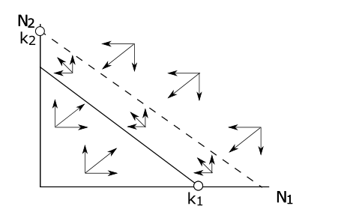
Inferring dynamics from the isoclines

Slide 25
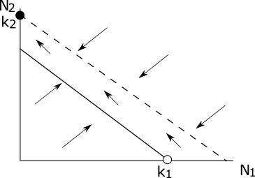
Lotka-Volterra interaction model: exclusion

Slide 26
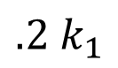
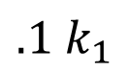
Lotka-Volterra interaction model: exclusion
We can numerically solve the differential equations and plot the solutions against time
Species 2 outcompetes and excludes species 1

Slide 27
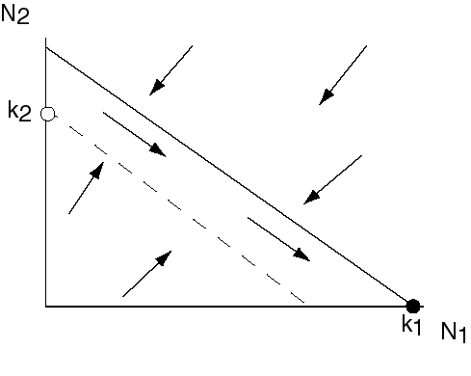
Lotka-Volterra interaction model: exclusion
Other outcomes of the model:
Species 1 can outcompete species 2

Slide 28
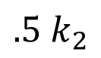
Lotka-Volterra interaction model: exclusion
This happens for different parameters
This looks very similar to Gause’s result

Slide 29
Gause’s experiments: Exclusion

Slide 30
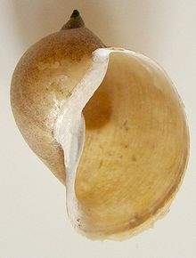
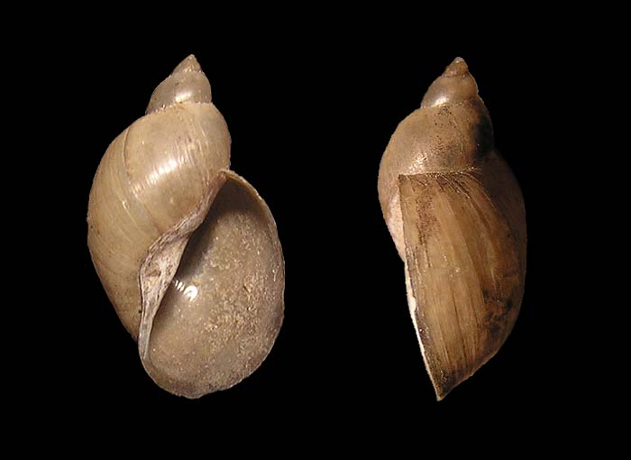
Exclusion of a watersnail in Wraysbury
Radix peregra and Radix auricularia are quite similar species. Their ranges overlap largely
R. auricularia tends to be found in large rivers. They are normally not found together.
Why? Do they simply occupy different habitat, or do they exclude each other?
Radix auricularia
Radix peregra
Radix aurucolaria

Slide 31
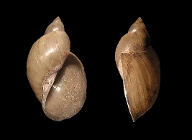

Exclusion of a watersnail in Wraysbury
R. Peregra closed bars, R. auricularia open bars
Adam and Lewis (1992) J. Moll. Stud. 58:227-8

Slide 32
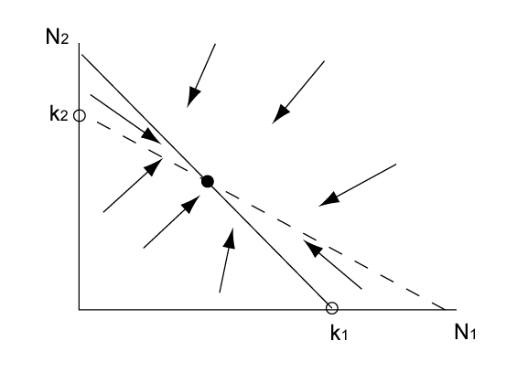
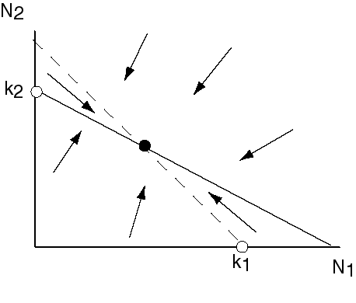
Lotka-Volterra interaction model: coexistence
Other outcomes of the model:
Species 1 and 2 can coexist

Slide 33
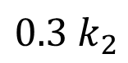
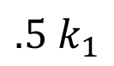

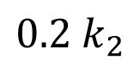
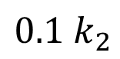
Lotka-Volterra interaction model: coexistence
This for different parameters
Gause also found coexistence

Slide 34
Gause’s experiments: Coexistence
Notes:
Stylonychia mytilus, Paramecium caudatum

Slide 35
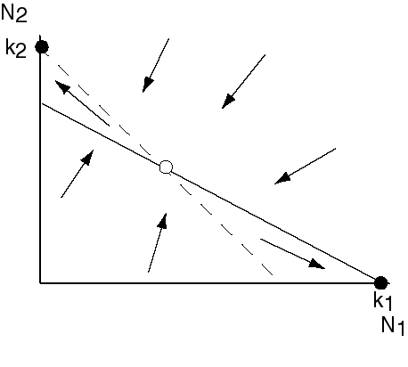
L-V interaction model: alternative stable states
Another outcome of the model:
An unstable equilibrium exists, yet there is no lasting coexistence. The winner of the competition depends on the initial conditions

Slide 36
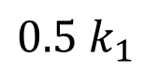
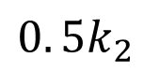
Alternative stable states
This for different parameters again
Either species 1 outcompetes species 2
Or, for different initial conditions, but the same parameters, the outcome is reversed

Slide 37
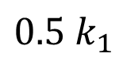

Alternative stable states

Slide 38
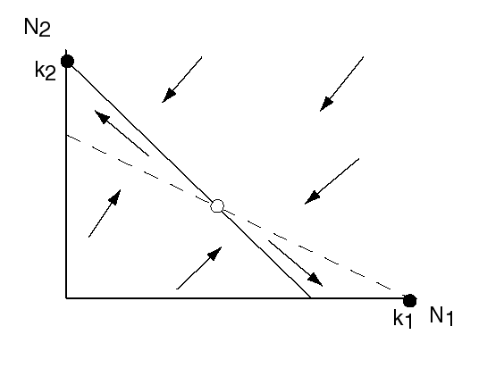
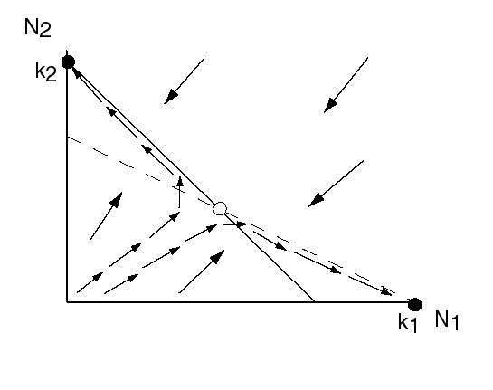
Alternative stable states

Slide 39
The phase plane
The previous plot captures the information about the solution in a very convenient way
Rather than plotting N₁ and N₂ versus time, we have plotted the values of N₁ and N₂ at various time points
The solution traverses the N₁, N₂ plane over time, the path it covers is called an orbit
The N₁, N₂ plane is the phase plane
All orbits together give you the phase portrait

Slide 40
Do Practical 2: Investigate the phase portrait of the Lotka-Volterra competition model

Slide 41
The phase plane

Slide 42
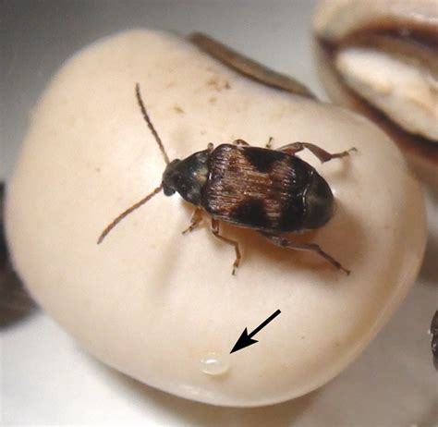
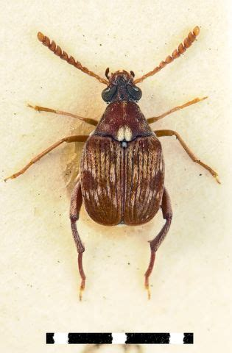
Competition between two beetles
Ishii and Shimada studied competition between the beetles Callosobruchus maculatus and C. chinensis.
The beetles were kept on different mixtures of azuki and black eye beans
Callosobruchus maculatus
Callosobruchus chinensis
Ishii, Y. and Shimada, M. (2008), Competitive exclusion between contest and scramble strategists in Callosobruchus seed–beetle modeling. Popul Ecol, 50: 197-205. https://doi.org/10.1007/s10144-008-0080-x

Slide 43
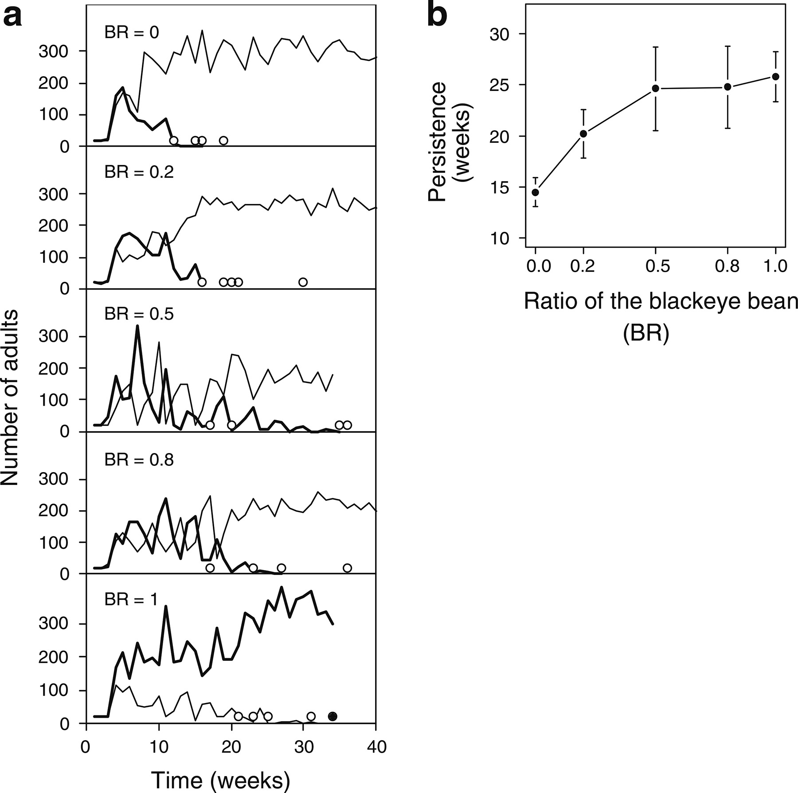
Competition between two beetles
Ishii, Y. and Shimada, M. (2008), Competitive exclusion between contest and scramble strategists in Callosobruchus seed–beetle modeling. Popul Ecol, 50: 197-205. https://doi.org/10.1007/s10144-008-0080-x

Slide 44
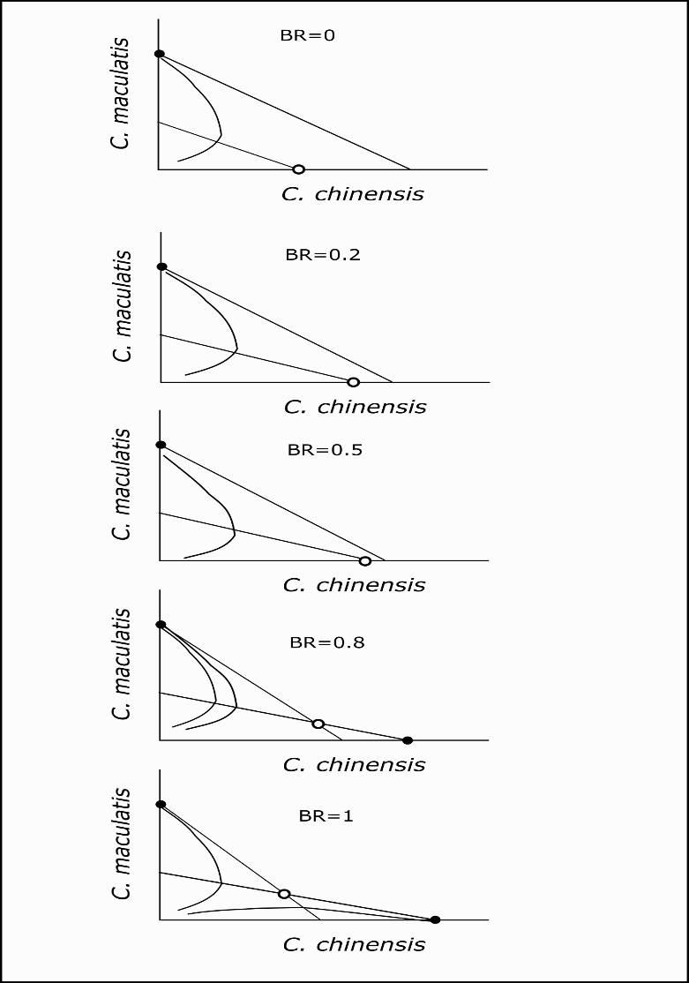
Competition between two beetles Data suggest the phase portrait changes as:

Slide 45
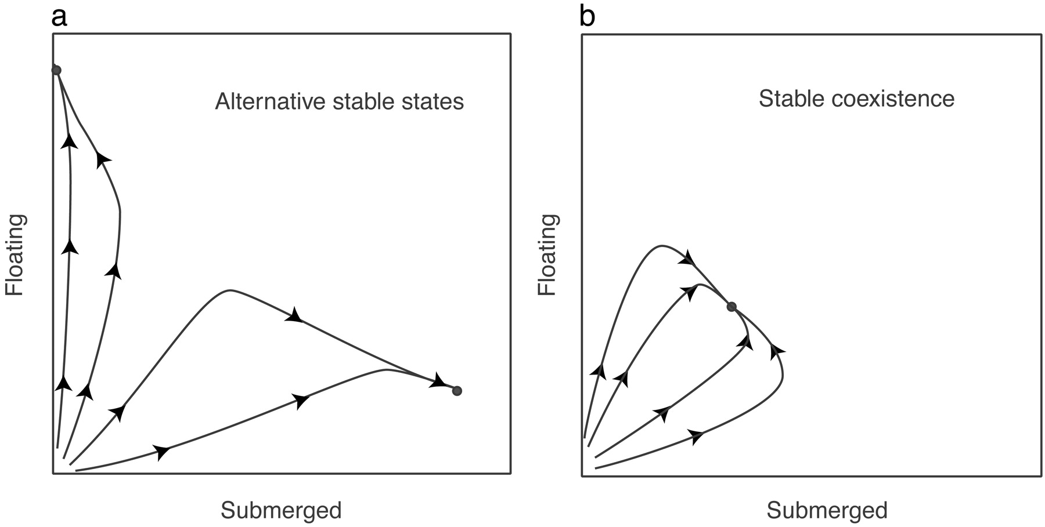
Theoretical growth trajectories in competition experiments of a submerged plant and a floating plant
Scheffer M et al. PNAS 2003;100:4040-4045
©2003 by The National Academy of Sciences
Notes:
(a) If two stable states exist, trajectories of simulations with our model end in either of the two states, depending on initial conditions. (b) By contrast, trajectories of simulations converge to the same point if there is a single equilibrium. The latter simulations are performed with hs = 0.2, rs = 1.2, and the other parameters at default values (see Table 1).

Slide 46
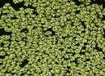
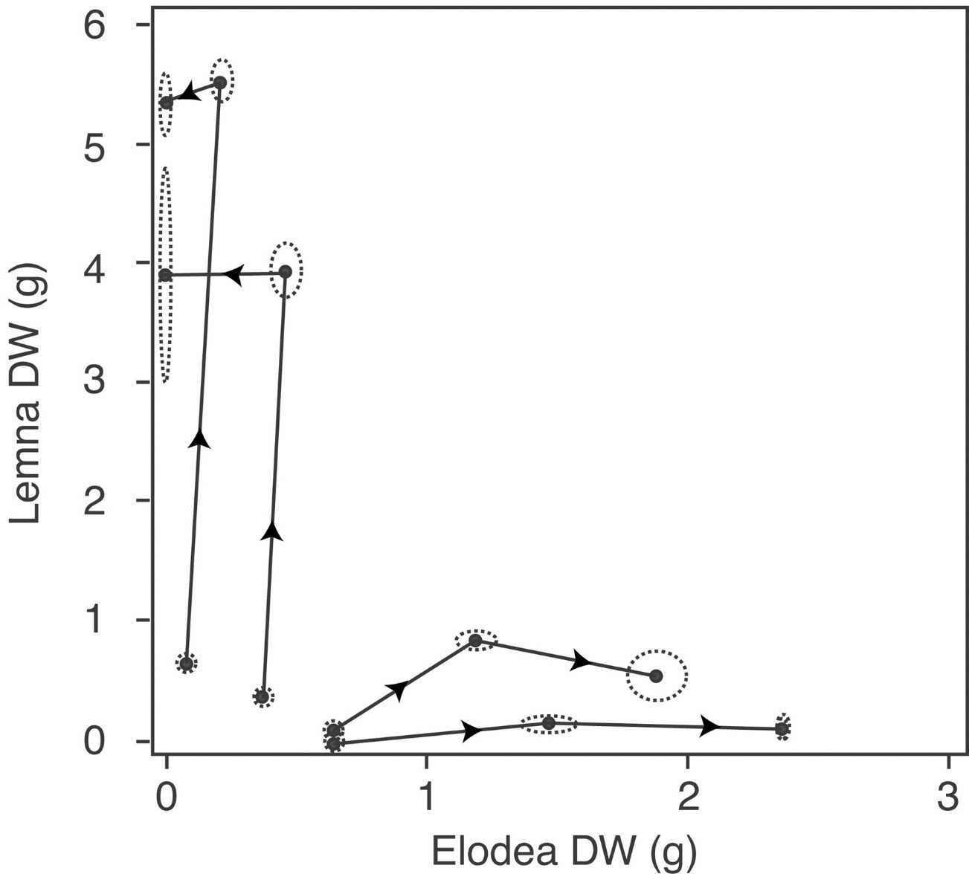
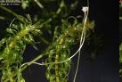
Observed growth trajectories in competition experiments of a submerged plant (Elodea) and a floating plant (Lemna) tend to different final states, depending on the initial plant densities
Scheffer M et al. PNAS 2003;100:4040-4045
©2003 by The National Academy of Sciences
Notes:
Growth trajectories in competition experiments of a submerged plant (Elodea) and a floating plant (Lemna) tend to different final states, depending on the initial plant densities. All experiments were performed under the same conditions. Biomass is plotted for all experiments at the 1st, 23rd, and 57th day. Dashed ellipses indicate SDs of replicate experiments.

Slide 47
Alternative Stable States in freshwater lakes
The two species compete for light and nutrients:
If the floating plants become dominant they block out light, preventing establishment of the benthic species
If the benthic plants become dominant they sequester the nutrients, preventing establishment of the floating species
The same principle seems to apply to many freshwater lakes, and explains the sudden change in turbidity in freshwater lakes under eutrophication (see Scheffer et al. 2001)

Slide 48
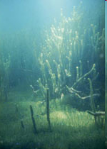
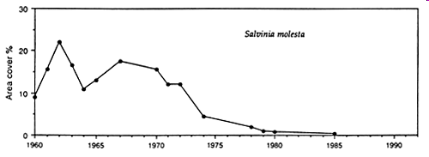
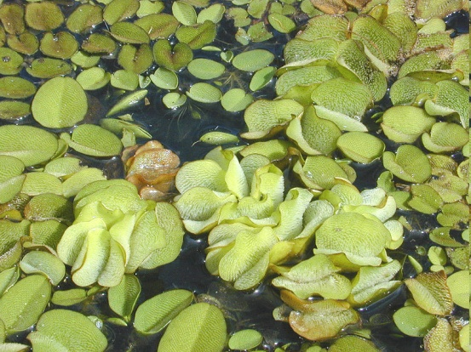
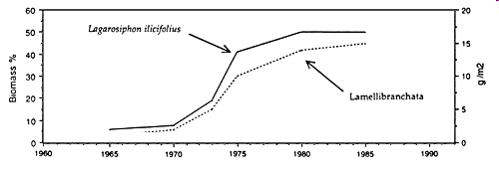
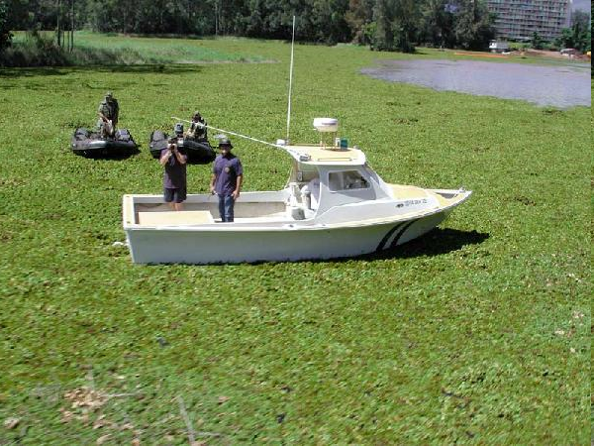
Changes in vegetation on Lake Kariba
Lagarosiphon major
Salvina molesta
Lake Kariba: coverage of Salvinia molesta, changes in the benthic (Lamellibranchiata) and aquatic macrophyte biomass (Lagarosiphon). (From Karenge and Kolding, 1995).
Notes:
Lamellibranchiata
Lemlibranchata: (Science: zoology) a class of mollusca including all those that have bivalve shells, as the clams, oysters, mussels, etc.

Slide 49
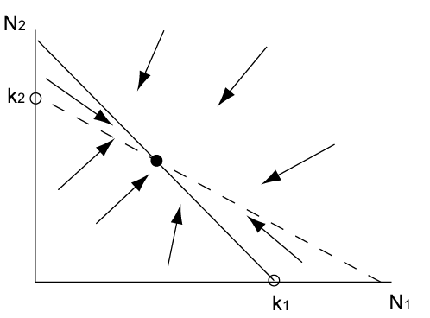
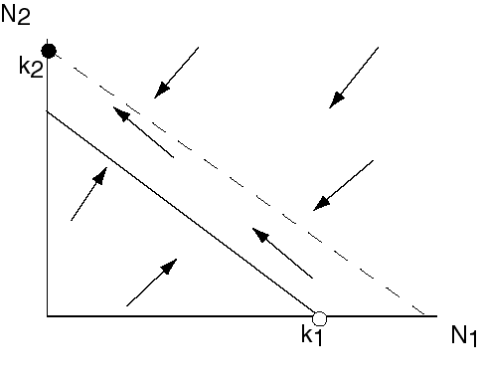
The outcomes of competition
Species 1 excludes 2
Species 2 excludes 1
Coexistence
Alternative stable states

Slide 50
Learning outcomes
Understand how intraspecific and interspecific competition both result from a reduction of the growth rate and the rationale behind the Lotka-Volterra interaction model
Know what an isocline is and how they can be used to infer dynamics
Know the possible outcomes of competition
Understand phase plots

Slide 51
Learning outcomes
Understand how intraspecific and interspecific competition both result from a reduction of the growth rate.
Understand the rationale behind the Lotka-Volterra interaction model

